Slide 1
Empower 2.0
Notes:
1

Slide 2
Business Requirements
Need to integrate an Admin Portal
Empower 2.0
Notes:
2
Empower 2.0 me kuch aur add karna hai

Slide 3
Challenges Identified
Admin Portal
For uploading any media business has to go through a tedious process.
Empower 2.0
Even when not in use, Empower servers are continuously running.
After CAB approval it requires involvement of HR technology team, IT release team and middleware team.
Server maintenance and upkeep also incurs cost.
Adequate server capacity based on future requirement needs to be provisioned which may not be continuously used.
Notes:
3

Slide 4
Core Solution
The main business requirement was the lack of an admin portal.
We implemented a cloud based admin portal with a business friendly frontend.
The business can upload all its media documents on the portal without any approvals, making the process extremely fast, simple and direct.
Notes:
4

Slide 5
Implementation
Based on file format, portal uploads file in required destination of S3 bucket
Business user uploads media directly to portal
Portal calls AWS lambda through AJAX query
Query returns the S3 bucket credentials
Portal uploads media in S3 bucket
Created a mechanism to choose file of any format which is automatically detected by the webpage
Notes:
5

Slide 6
Proposed Solutions
Storage Gateway
Cloud Native Empower
Notes:
6

Slide 7
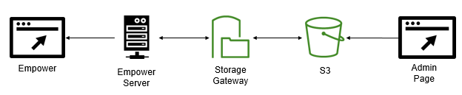
AWS Storage Gateway
The admin page based upload can be integrated with existing Empower architecture by leveraging AWS Storage Gateway
The admin page can be used to directly upload files to the S3 bucket
Notes:
7

Slide 8




Cloud Native Empower
Admin portal is a cloud based solution that can integrate well in any scenario
Based on other challenges identified, a serverless empower can be a good alternative to existing arrangement.
Using various cloud services such as Lambda, DynamoDB, Cognito etc we implemented a serverless empower.
Notes:
8

Slide 9
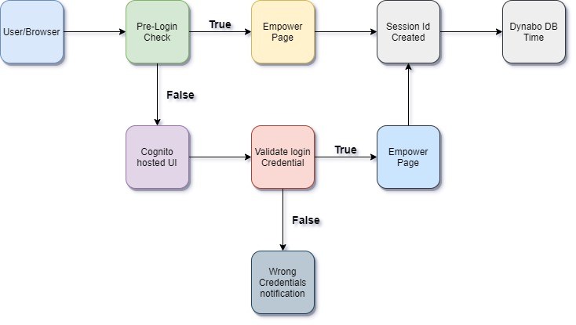
Logic Flow
Notes:
9

Slide 10
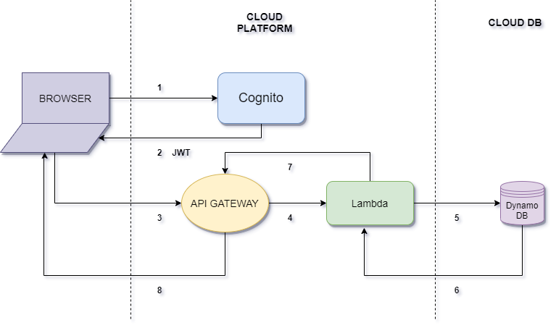
Architecture
Notes:
10

Slide 11
Cost Benefit Analysis
vs
Admin page
Empower 2.0
Human effort reduction
Flexible operation of empower
Human effort reduction
Serverless architecture
Cost of Existing Empower
Let us take an employee getting paid Rs 1000000/year. He needs to approach another two more persons to upload anything to Empower. If they spend 10 hours in a month on getting approvals. Company is spending around (1000000/220*9)*10*12*3 or Rs 180000/year which can be saved.
Apart from this, we have maintenance cost of the servers and employees deployed to maintain the servers of empower which can be reduced if we adopt the newer version of the empower.
Notes:
11

Slide 12
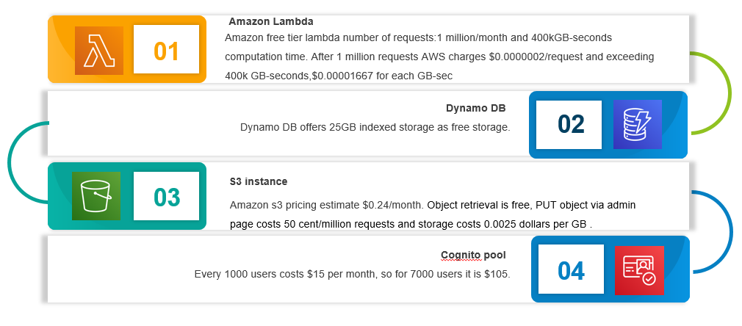
Cost of Empower 2.0
Notes:
12

Slide 13
Impact
Empower 2.0 is cloud based & serverless eliminating need for server provisioning maintenance and upkeep.
Improved the scalability of the system.
Added an Admin portal, no additional approvals are required.
Ability to modify data in current Empower using ADMIN page.
Different file formats can be uploaded.
Highly economic portal.
Notes:
13

Slide 14
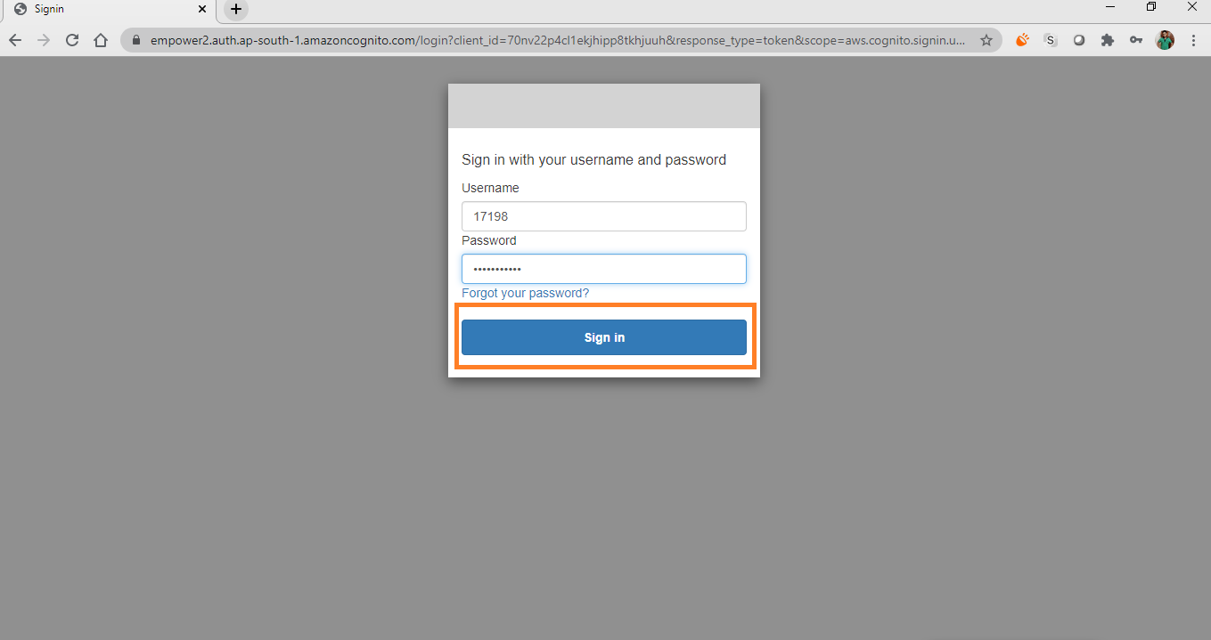
Annexure
Notes:
14

Slide 15
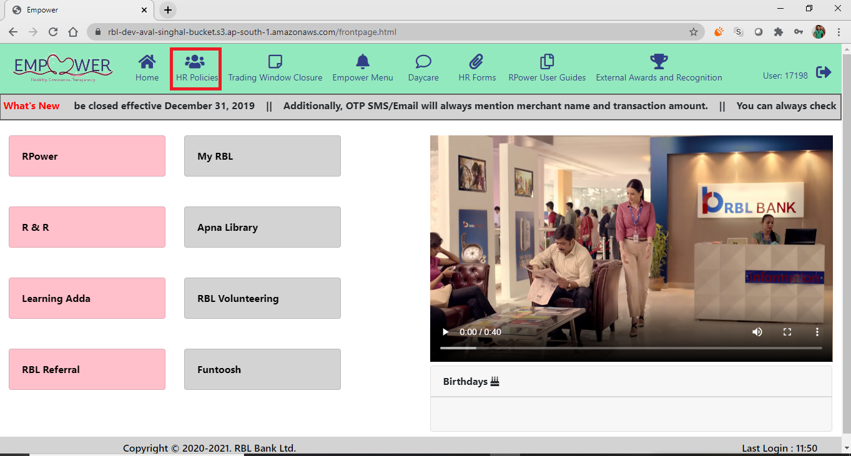
Annexure
Notes:
15

Slide 16
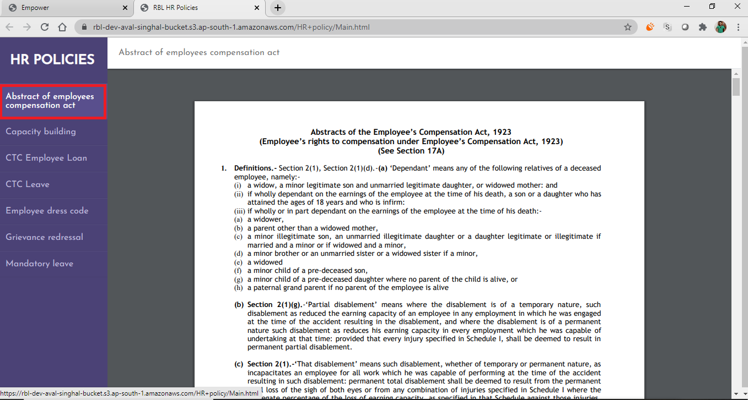
Annexure
Notes:
16

Slide 17

Annexure
Notes:
17

Slide 18
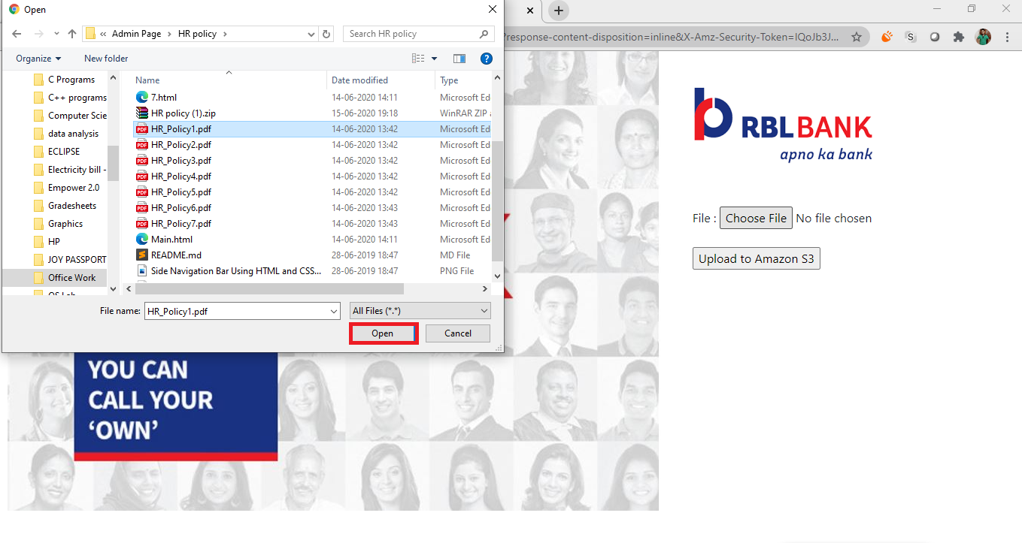
Annexure
Notes:
18

Slide 19

Annexure
Notes:
19

Slide 20
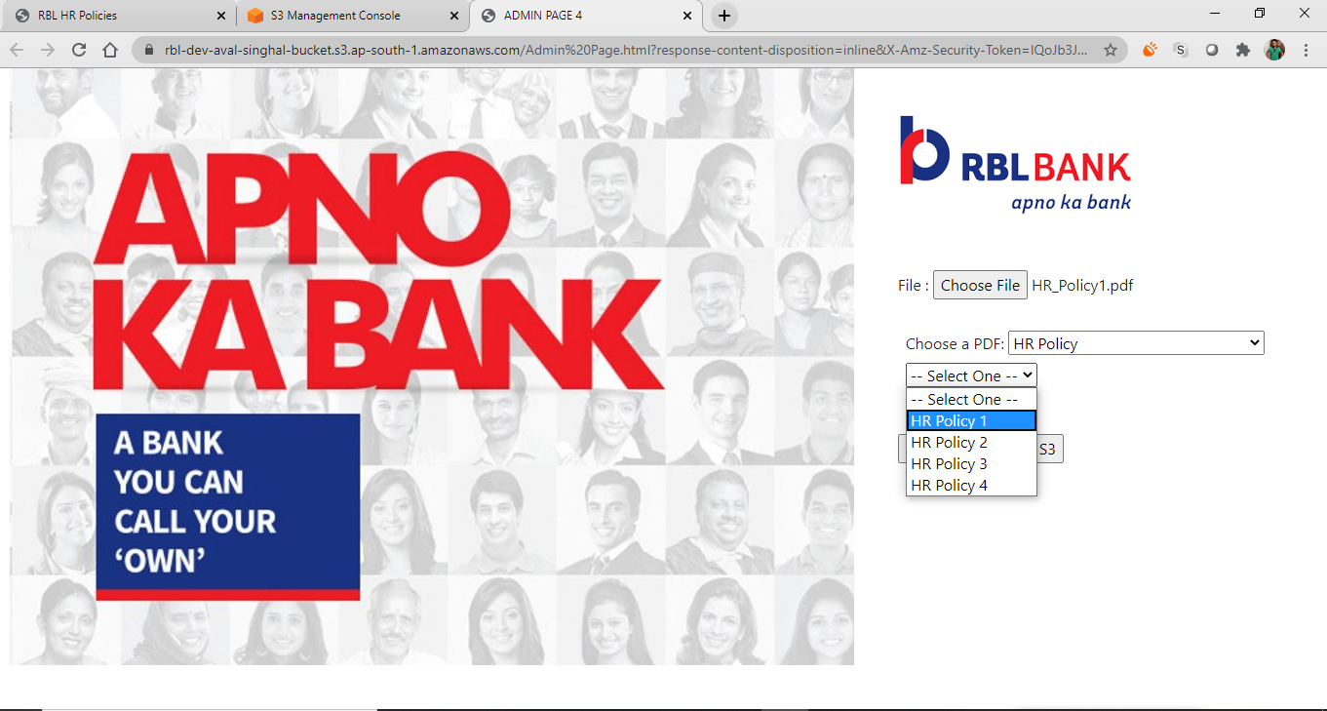
Annexure
Notes:
20

Slide 21

Annexure
Notes:
21

Slide 22

Annexure
Notes:
22

Slide 23
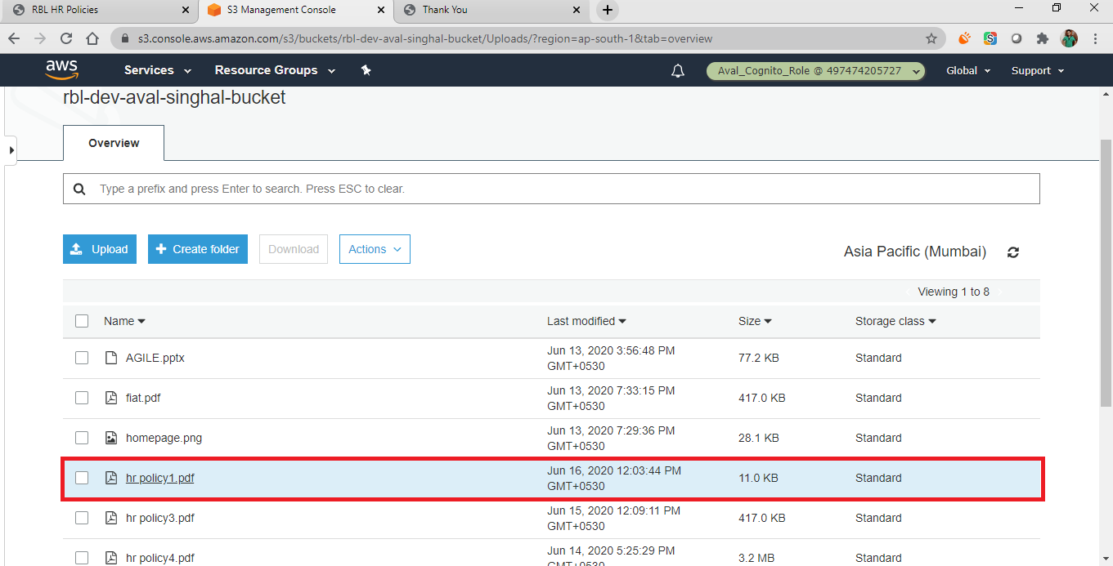
Annexure
Notes:
23

Slide 24
Additional Projects
COVID Chat-bot Hackathon
Data Visualisation of Employees/ ATMs/ Branch/ Offices in COVID Zones using Thoughtspot
Official Chat-bot Maintenance & Analytics
Customer data analysis for MoBank and MyCard
Deploy Mediawiki Server (Ongoing)
Infographics for IT Communication
Notes:
24

Slide 25
Key Learnings
Notes:
25

Slide 26
26

